Slide 1

Domain: MATLAB
Technology: COMMUNICATION
IMPLEMENTATION OF MULTIHOP PROTOCOL WITH COST FUNCTION FOR DECREASING ENERGY CONSUMPTION IN NODES

Slide 2
Index
Abstract
Introduction
Literature review
Existing Method
Disadvantages
Proposed method
Advantages
Hardware and Software Requirements
Results
Conclusion
References

Slide 3
Abstract
We present a routing protocol for Wireless sensor Networks that is reliable, power efficient, and has a high throughput (WSNs). To reduce energy consumption and increase network longevity, we employ a multi-hop topology. To identify the parent node or forwarder, we offer a cost function. The proposed cost function chooses a parent node with the highest residual energy and the shortest distance to the sink. The residual energy parameter balances energy consumption across sensor nodes, while the distance parameter guarantees packet delivery to the sink is successful.
Our suggested approach decreases the energy consumption of nodes which helps in maximizing the network lifetime.
Keywords-- Wireless Sensor Network, Cost Function, energy consumption

Slide 4
Introduction:
Technology advancements have created a numerous chances for resource efficiency in critical environments. In this context, Wireless Sensor Networks (WSNs) have ushered in a revolution. With the development of this technology, it became possible to collect and distribute useful information to the desired location [1]. These schemes can be used to monitor applications such as battlefield surveillance, smart offices, traffic monitoring, and so on.
Sensor nodes in WSNs are powered by a finite amount of energy. Data transmission from sensor nodes to sink must use the least amount of power possible. Battery recharge is one of the most difficult challenges in WSN. To address the problem of battery recharging, an efficient routing protocol is necessary. WSN technology [4], proposes a number of energy-efficient routing methods.
For WSN, we present a routing protocol that is high throughput, reliable, and stable. In a given area, we set up sensor nodes. Near the sink, sensors are positioned. Because sensors carry data and require low attenuation, great reliability, and extended life, they always send data directly to the sink. Other sensors track their parent node and send data to the sink via the forwarder node. It conserves node energy and allows the network to operate for longer.

Slide 5
Literature review:
S. NO | Journal Type with year | Authors | Title | Outcomes
1 | 2012 15th International Multitopic Conference (INMIC). | T. Shah, N. Javaid, T. N. Qureshi | Energy Efficient Sleep Awake Aware (EESAA) Intelligent Sensor Network Routing Protocol | Studied about the (EESAA) intelligent routing protocol for WSNs.
2 | System Sciences, 2000. Proceedings of the 33rd Annual Hawaii International Conference on. IEEE, 2000. | Heinzelman, Wendi Rabiner, Anantha Chandrakasan, and Hari Balakrishnan | Energy-efficient communication protocol for wireless microsensor networks | Studied about LEACH (Low-Energy Adaptive Clustering Hierarchy).
3 | Proc. Wireless Communications and Mobile Computing Conference, 2011, pp. 842–847. | Y. Ebrahimi and M. Younis | Using deceptive packets to increase base station anonymity in Wireless Sensor Network | Studied about boosting the anonymity of the base-station
4 | Proceedings of the 1st ACM international workshop on Wireless sensor networks and applications. ACM, 2002. | aring, Alan, et al | Wireless sensor networks for habitat monitoring | Studied about the requirements for habitat monitoring.
5 | 2nd IEEE Saudi International Electronics, Communications and Photonics Conference (SIECPC 13), 2013, Riyadh, Saudi Arabia. | N. Javaid, U. Qasim, Z. A. Khan, M. A. Khan, K. Latif and A. Javaid | On Energy Efficiency and Delay Minimization in Reactive Protocols in Wireless Multi-hop Network | Studied about NS2 tool, Linear Programming models (LP_models)

Slide 6
Existing methods:
Improved energy-efficient clustering protocol (IEECP) The proposed protocol reduces and balances the energy consumption of nodes by improving the clustering structure, where IEECP is suitable for networks that require a long lifetime. The evaluation results prove that the IEECP performs better than existing protocols.
First, an optimal number of clusters is determined for the overlapping balanced clusters. Then, the balanced-static clusters are formed on the basis of a modified fuzzy C-means algorithm by combining this algorithm with a mechanism to reduce and balance the energy consumption of the sensor nodes. Lastly, cluster heads (CHs) are selected in optimal locations with rotation of the CH function among members of the cluster based on a new CH selection-rotation algorithm by integrating a back-off timer mechanism for CH selection and rotation mechanism for CH rotation.
The proposed protocol which consists of three parts: determination of the optimal number of clusters based on a modified mathematical model, formation of balanced clusters based on a modified Fuzzy C-means (M-FCM) and selection and rotation of the CH for clusters based on the CH selection-rotation algorithm (CHSRA).

Slide 7
Disadvantages in Existing methods:
1. Complexity.
2. More energy consumption.

Slide 8
Proposed method:
A new technique to reduce energy use while increasing throughput.
Our contribution consists of the following:
The stability period of our proposed scheme is longer. Nodes are able to stay alive for longer periods of time while using the least amount of energy possible.
High throughput is aided by a long stability period and low node energy consumption.
We deploy numerous nodes in a region under this scheme. The power and compute capability of all sensor nodes are identical.
Two nodes are chosen, and these two nodes will transport data directly to the sink
A. Proposed Protocol:
First Phase
Forwarder Node Selection
Scheduling

Slide 9
First Phase
Sink broadcasts its location through short information packet
Sensor nodes store the location of sink
Each sensor transmits short information packet to sink which contains node ID, its residual energy and location
Sink broadcasts information to all sensors

Slide 10
Forwarder Node Selection
Minimum cost function value is used to select optimal data forwarder
A node with high residual energy and less distance to sink has minimum cost function
Cost Function (i) = distance (i) /Residual Energy (i)
Cost function value ensures new forwarder in each round

Slide 11
Scheduling
Forwarder node assigns TDMA schedule to its children node
Children nodes transmit their data in allocated time slot
TDMA scheduling saves energy of sensor nodes.

Slide 12
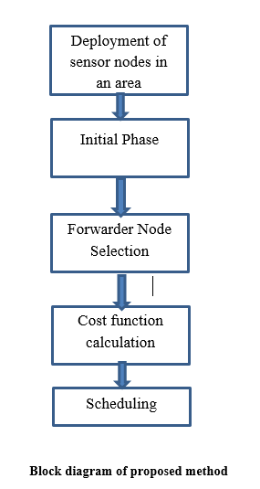
BLOCK DIAGRAM

Slide 13
Advantages of Proposed method:
1.Less Complexity
2.Less energy consumption.

Slide 14
Applications:
1.Industrial control
2.Environmental monitoring,
3. Military surveillance,
4.Intelligent transportation systems and medical field.
5.Furthermore, it can function independently in harsh or high-risk places where human presence is not possible
6.Disaster relief operations.
7.Biodiversity mapping
8.monitoring of temperature, pressure, and humidity

Slide 15
Hardware and Software Requirements:
Hardware & Software Requirements:
Software: Matlab R2018a.
Hardware:
Operating Systems:
• Windows 10
• Windows 7 Service Pack 1
• Windows Server 2019
• Windows Server 2016
Processors:
Minimum: Any Intel or AMD x86-64 processor
Recommended: Any Intel or AMD x86-64 processor with four logical cores and AVX2 instruction set support
Disk:
Minimum: 2.9 GB of HDD space for MATLAB only, 5-8 GB for a typical installation
Recommended: An SSD is recommended a full installation of all Math Works products may take up to 29 GB of disk space
RAM:
Minimum: 4 GB
Recommended: 8 GB

Slide 16
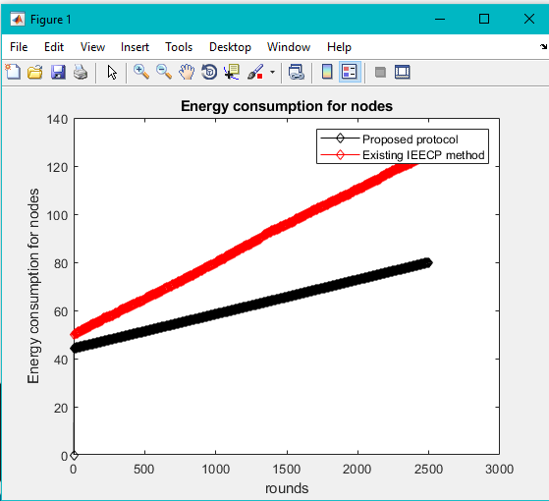
Results and Discussions:
We compared the proposed protocol's performance to that of the existing IEECP protocol.
Figure : Energy consumption for effective network

Slide 17
CONCLUSION:
We propose a data routing mechanism in WSNs in this research. To choose an appropriate route to sink, the suggested scheme uses a cost function. The cost function is determined by the nodes' leftover energy and their distance from the sink. The parent node is chosen by the nodes with the lowest cost function value. Other nodes join the parent node as children and send their data to it. Due to their proximity to the sink, two nodes forward their data directly to it; yet, these two nodes cannot be elected as parent nodes because both sensor nodes contain crucial and important data. It is not necessary for these two nodes to expend energy forwarding data from other nodes.

Slide 18
References:
[1] T. Shah, N. Javaid, T. N. Qureshi, "Energy Efficient Sleep Awake Aware (EESAA) Intelligent Sensor Network Routing Protocol," 2012 15th International Multitopic Conference (INMIC).
[2]Heinzelman, Wendi Rabiner, Anantha Chandrakasan, and Hari Balakrishnan. “Energy-efficient communication protocol for wireless microsensor networks.” System Sciences, 2000. Proceedings of the 33rd Annual Hawaii International Conference on. IEEE, 2000.
[3] Y. Ebrahimi and M. Younis, “Using deceptive packets to increase base station anonymity in Wireless Sensor Network,” in Proc. Wireless Communications and Mobile Computing Conference, 2011, pp. 842–847.
[4] aring, Alan, et al. “Wireless sensor networks for habitat monitoring.” Proceedings of the 1st ACM international workshop on Wireless sensor networks and applications. ACM, 2002
[5] N. Javaid, U. Qasim, Z. A. Khan, M. A. Khan, K. Latif and A. Javaid, “On Energy Efficiency and Delay Minimization in Reactive Protocols in Wireless Multi-hop Network”, 2nd IEEE Saudi International Electronics, Communications and Photonics Conference (SIECPC 13), 2013, Riyadh, Saudi Arabia.

